Slide 1
CREDIT CARD FRAUD DETECTION
Classifying fraudulent credit card transactions

Slide 2
TABLE OF CONTENTS
01
04
02
05
03
Model Training and Evaluation
Introduction
Data Preprocessing
Results Interpretation
Naive Bayes Classifier

Slide 3
01
Introduction

Slide 4

Background info on credit card fraud
01 - Introduction
In 2019, the total cost of fraudulent transactions involving SEPA-issued and obtained cards worldwide was €1.87 billion.
The total value of fraudulent card transaction for cards issued just in the eurozone was €1.03 billion.
Credit card companies must be able to detect fraudulent credit card transactions so that clients are not charged for products they did not purchase.

Slide 5
Credit card fraud detection
01 - Introduction
To detect fraudulent transactions, banks and credit card firms are increasingly using AI and machine learning algorithms.
These models examine enormous volumes of transaction data and employ a variety of algorithms and approaches to detect patterns and abnormalities that may suggest fraudulent behavior.
We will utilize a simple machine learning algorithm called the Naive Bayes classifier, to identify fraudulent transactions within a public dataset.

Slide 6
02
Data Collection & Preprocessing

Slide 7
DATA COLLECTION
USING PUBLIC DATASET
The used dataset was obtained from Kaggle. The dataset includes credit card transactions performed by European cardholders in September 2013.
CONTENT OF THE DATASET
This dataset contains 492 frauds out of 284,807 transactions that occurred over the course of two days. The dataset is very unbalanced, with transactions that are positive accounting for 0.172% of all transactions.

Slide 8
DATA DESCRIPTION
DATASET FEATURES
The dataset contains total of 31 columns as following:
Column “Class” is the observation label. The values of 1 represent the fraudulent transactions while values of 0 represent non-fraud ones
28 Columns named “V1, V2, …., V28” that represent transaction features and additional background information on the data, unfortunately, they are unable to offer the original features for confidentiality and provided as a result of a PCA transformation.
The only columns/features that have not been changed with PCA are 'Time' and 'Amount'. Feature 'Time' is the number of seconds that have passed between each transaction and the first transaction in the dataset. The transaction Sum is represented by the feature 'Amount'

Slide 9
PCA TRANSFORMATION
Understanding PCA
PCA is a statistical approach used in data analysis to reduce dimensionality. It reduces a large number of variables to a smaller number of uncorrelated variables known as main components while retaining as much original information as possible. The amount of variance explained by these components is ranked. PCA simplifies datasets by assuming linearity and normalcy, although it might be challenging to interpret.
PCA IN CREDIT CARD FRAUD DETECTION
PCA was applied to numerical input variables in the context of credit card transaction analysis to preserve the anonymity and confidentiality of the original data.

Slide 10
DATA CLEANING
1
2
3
4
Handling Imbalanced Data
Removing Duplicated
Removing Null Values
Removing outliers

Slide 11
DATA CLEANING
Removing Duplicates
Removing redundant entries to ensure unique data integrity
during the cleaning process
Removing Null values
Removing null values to ensure data completeness during
the cleaning process
Removing Outliers
Removing Outliers using IQR method to improve the reliability of the statistical analysis during the cleaning process

Slide 12
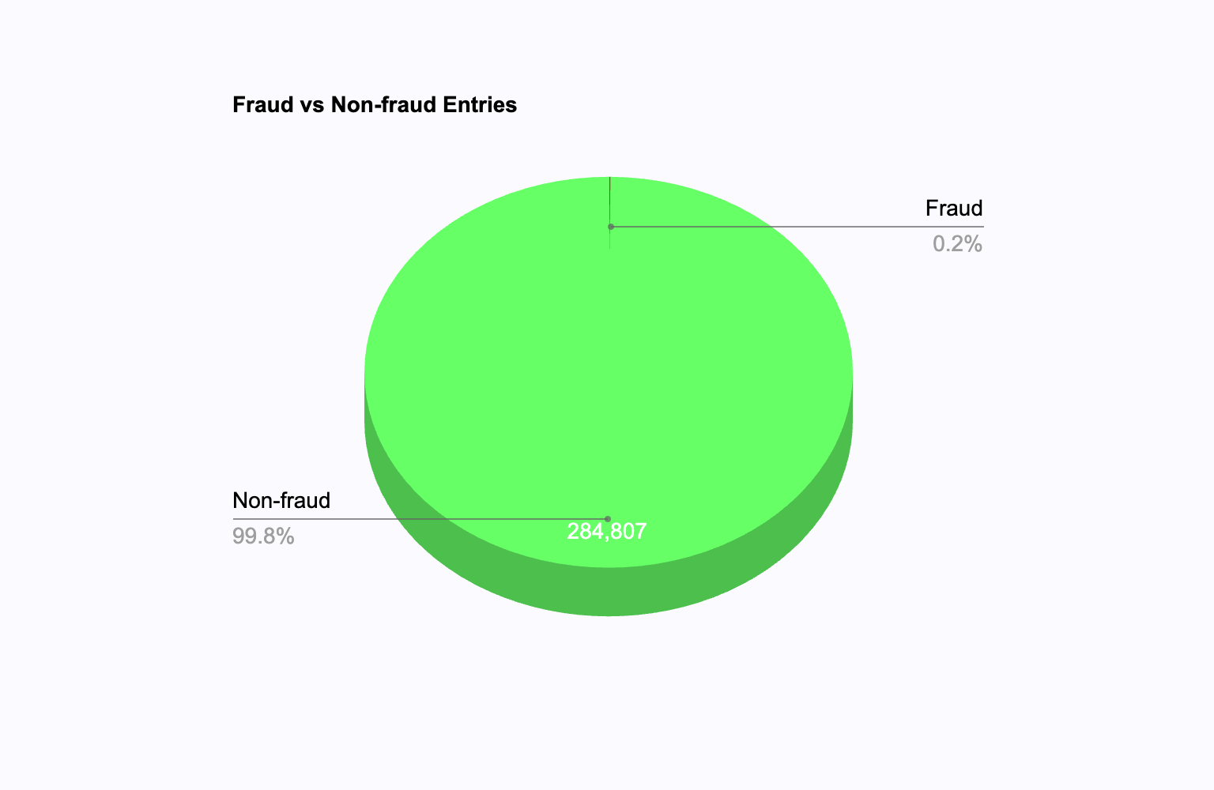
HANDLING IMBALANCED DATA
We were presented with a challenge since the obtained data was extremely imbalanced with 492 frauds out of 284,807 total transactions. We had to deal with this imbalance as the Naive Bayes Classifier is affected by imbalanced input

Slide 13
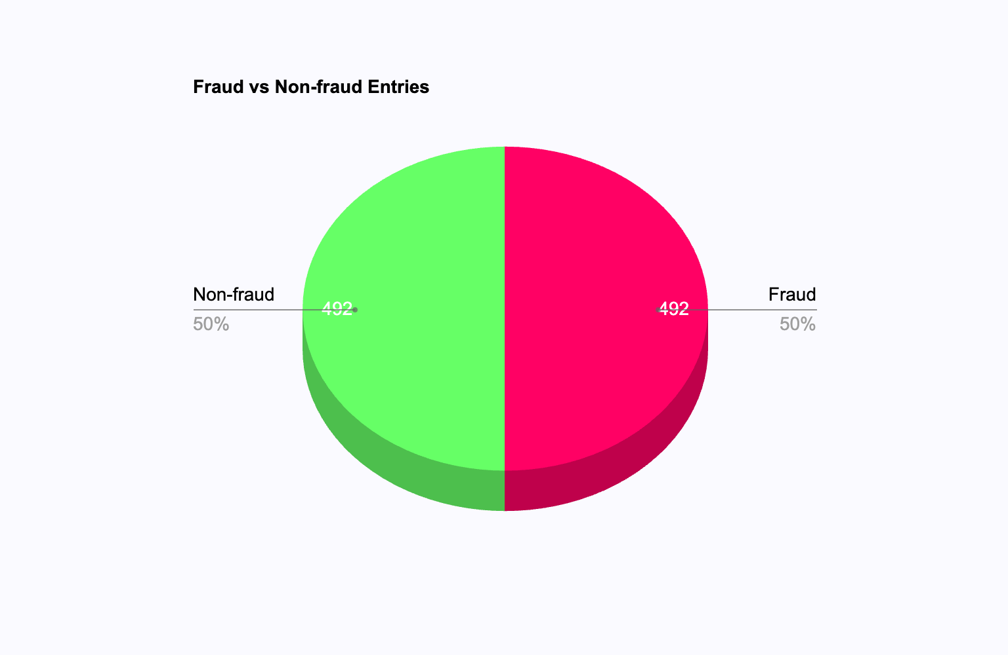
HANDLING IMBALANCED DATA
BEFORE
AFTER

Slide 14
03
Naive Bayes
Classifier

Slide 15
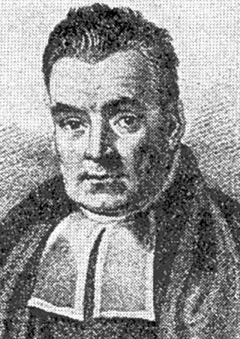
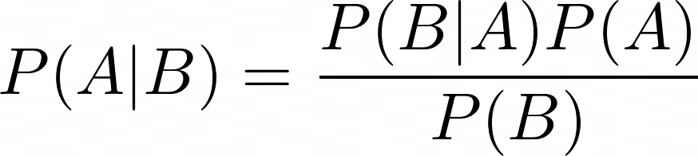
Background info on Bayes’ Theorem
Bayes theorem is the law behind the Naive Bayes Classification Algorithm. The significance of the Bayes' theorem lies in its ability to update our beliefs or probabilities about an event as new information becomes available.

Slide 16
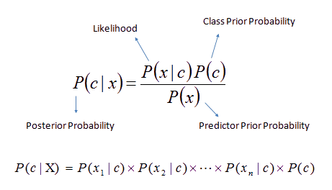
Naïve Bayes Classifier
The Naive Bayes algorithm is a probabilistic machine learning algorithm used for classification tasks.
Naive Bayes has an important assumption which is feature independence.
Naïve Bayes Algorithm:
We aim to find C what maximizes the posterior
So we will compute the product of likelihood and prior and look for the one that satisfies our goal
The evidence will be neglected because:
it's not dependent on c
hard to compute
Where:
C is the class (which fraud or non-fraud transaction)
X represents the features we have

Slide 17
TYPES OF NAIVE BAYES CLASSIFIER
Gaussian Naive Bayes
Multinomial Naive Bayes
Gaussian Naive Bayes: This classifier is based on the assumption that the input features have a Gaussian or normal distribution. It is typically used for variables with continuous input.
For discrete input variables, such as the frequency of words in a text corpus, this form of the classifier is used. It is presumptively assumed that the input features are drawn from a multinomial distribution.
Bernoulli Naive Bayes
This classifier is also used for discrete input variables, but it is based on the assumption that the input features are binary or Boolean in nature. It predicts whether each input feature will be present or absent in a document and is often used in text classification problems where the presence or absence of words is utilized as a feature.

Slide 18
ADVANTAGES AND LIMITATIONS OF NAIVE BAYES
ADVANTAGES
LIMITATIONS
Simplicity and ease of implementation.
Scalability to high-dimensional datasets.
Good performance in practice, especially in text classification.
Robustness to noise and irrelevant features.
Interpretable results that can be easily explained.
Strong independence assumption may not hold in practice.
Limited expressivity, only able to model linear relationships between features and class labels.
Sensitivity to feature scaling, assumes all features have same variance.
Handling of unseen data, may assign zero probability to unseen data.
Poor performance in imbalanced class situations.

Slide 19
04
Model Training and Evaluation

Slide 20
MODEL TRAINING
After dividing the dataset into training and testing sets, we proceed to train our Naive Bayes classifier using the training data. This involves feeding the classifier the labeled training data and allowing it to learn the relationships between the features and the corresponding class labels.
Once the classifier is trained, we evaluate its performance using the testing data, which has not been seen by the classifier before. This allows us to measure how accurately the classifier can predict the class labels of new, unseen instances. We then calculate the accuracy of the model by comparing the predicted labels with the true labels in the testing data.
Splitting the dataset into
Training data | 80%
Testing data | 20%

Slide 21
EVALUATION METRICS (FOR OUR MODEL)
Accuracy : measures the overall correctness of the model. It is the ratio of correct predictions to total predictions.
Precision : measures the model's ability to correctly identify positive instances. It is the ratio of true positives to positive predictions.
Recall : measures the model's ability to find all positive instances. It is the ratio of true positives to actual positives + False Negatives.
F1 score : is the harmonic mean of precision and recall and provides a balanced measure.
ACCURACY | 0.91
PRECISION | 0.94
RECALL | 0.85
F1 SCORE | 0.89

Slide 22
05
Results

Slide 23
HOW DID THE MODELS DO?
 | Naive Bayes (Our classifier) | Naive Bayes (Scikit-Learn) | Decision Tree (Scikit-Learn) | Logistic Reg (Scikit-Learn)
Recall Score | 0.85 | 0.85 | 0.9 | 0.91
Precision Score | 0.94 | 0.94 | 0.85 | 0.98
F1 score | 0.89 | 0.89 | 0.87 | 0.95
Accuracy | 0.91 | 0.91 | 0.88 | 0.96

Slide 24
INTERPRETATION OF RESULTS
In evaluating the performance metrics, our classifier showcased a pretty good accuracy, placing it right behind logistic regression. Additionally, our classifier exhibited the a high F1 score, emphasizing its effectiveness in achieving a balance between precision and recall. Notably, the Gaussian Naive Bayes model did well in precision, while the logistic regression outperformed our model in every evaluation metric. Our classifier also demonstrated notable performance in recall, further confirming its reliability for classification tasks.

Slide 25
THANKS!
DOES ANYONE HAVE ANY QUESTIONS?
Team 11
Abdulrehman Emad
Amir Hesham
Habiba Salama
Mariam Ahmed
Mohamed Mosilhe

